Slide 1
Chapter 23

Slide 2
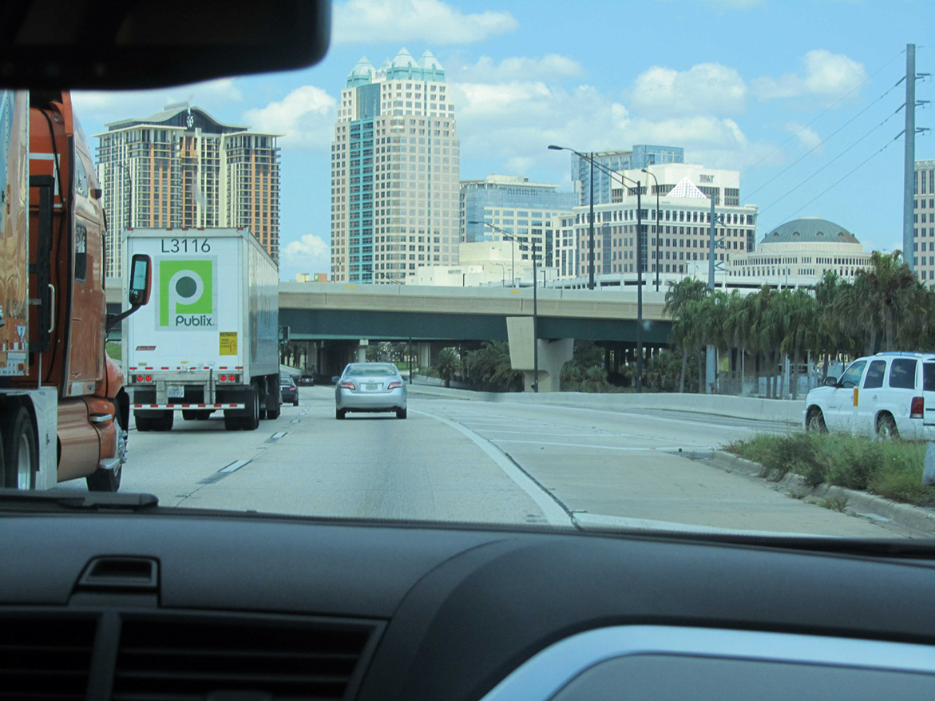
Figure 1 Are we there yet?

Slide 3
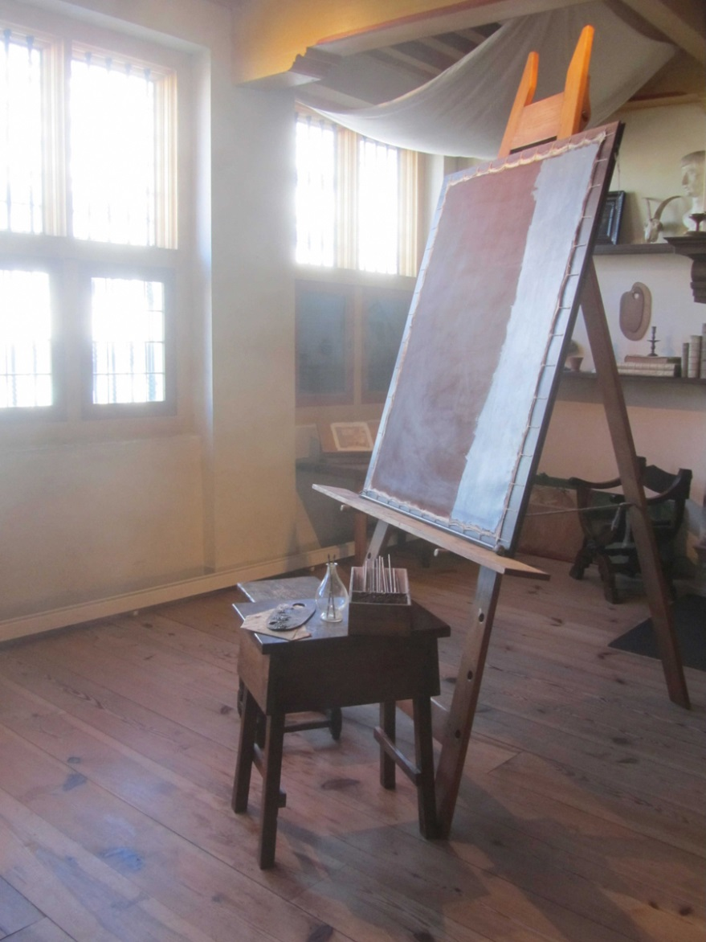
Figure 2 Is this a stimulating work environment? It worked for Rembrandt.

Slide 4
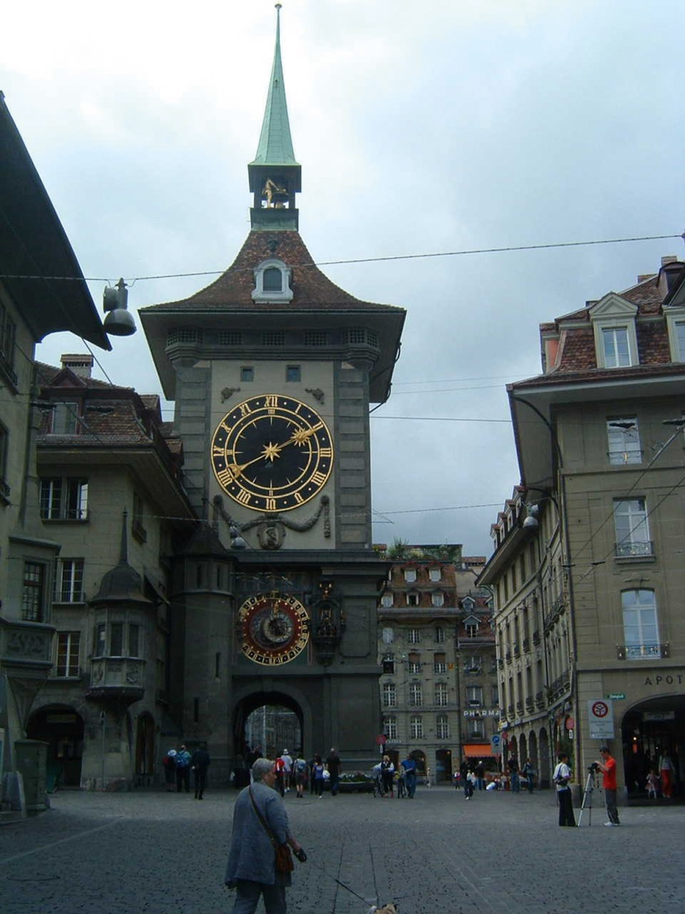
Figure 3 Time stands still in the street where Einstein lived—is the speed at which time passes relative to our emotions?

Slide 5
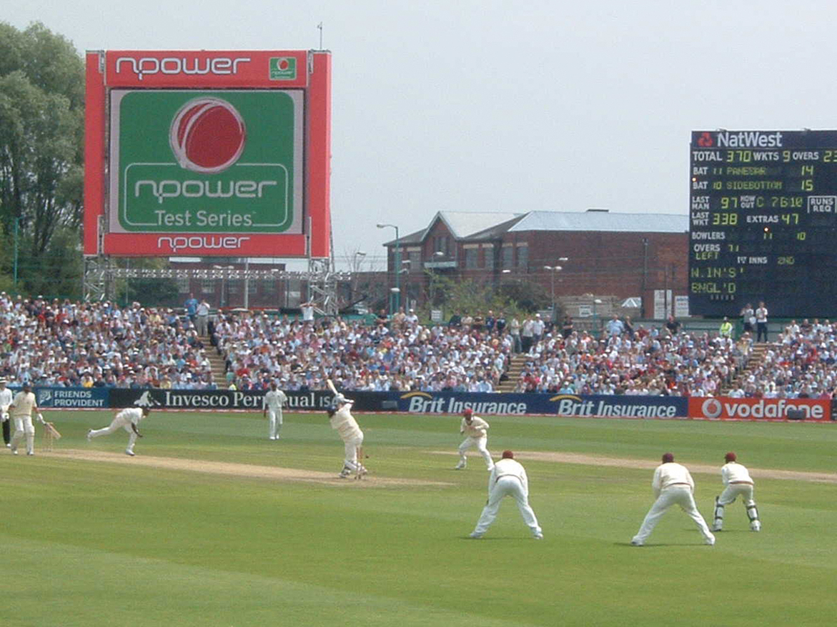
Figure 4 Would you find it hard to watch a cricket match for 5 days?

